Slide 1



Mass-suite: A novel open-source Python package designed for HRMS data analysis
https://github.com/XiminHu/mass-suite
Ximin Hu¹, Derek Mar⁴, Nozomi Suzuki⁴, Bowei Zhang⁴, David A. Beck³, Edward P. Kolodziej²
1. Civil and Environmental Engineering, University of Washington, Tacoma, WA, United States. 2. Sciences and Mathematics (UWT); Civil and Environmental Engineering (UWS), University of Washington (Tacoma/Seattle), Tacoma, WA, United States. 3. Chemical Engineering, University of Washington, Seattle, WA, United States. 4. Materials Science and Engineering, University of Washington, Seattle, WA, United States.
Notes:
Add logos

Slide 2
Introduction
Why
Mass-suite
-Python is popular
-Full-stack capability
-Data science approaches
High Resolution Mass Spectrometry
-Novel technology
-Huge data
-Limited tools available
Environmental Pollutants
-Complicated in environment
-Challenge in identification & tracking
https://github.com/XiminHu/mass-suite
Notes:
HRMS as we all know, is a powerful emerging technique, and used a lot in the environmental studies. The huge data collection capability provides various information while hard to be handled.
Lot of tools are available now but more or less limited in processing the HRMS data. Some workflows were integrated so user can’t get into the middle and change settings, some workflows are good at specific functions but may lack
Other essential functions, so user needs to hop around different tools to get their data processed
Thus, we would like to introduce mass-suite here.
Mass suite is built on the most popular programming language python, and designed to providing a full-stack capability for the HRMS data processing, from data import to detailed analysis
It is more concentrating on the non-targeted analysis, and driven by data science approaches
Python – Kaggle survey showed 81% users choose Python as primary programming language for data science related project, 2019

Slide 3










Overview of Mass-suite
data processing
Always new
Essential functions for HRMS data processing:
Mzml import
Peak picking & Alignment
Blank subtraction
Data curation
More..
There are always something new:
Source identification
Source quantitative apportionment
MS2 data mining
Even more..
visualization
Other tools
Various plot tools for visualizing HRMS data:
Chromatograms
Spectrums
Static/Interactive options
More..
Data mining
HRMS data processing assisting tools:
Formula annotation
MS2 spectrum online search
HRMS data quality report
More..
Explore HRMS data with data science tools:
Principle Component Analysis
T-SNE Dimension reduction
Clustering analysis based on DBSCAN/OPTICS
Various modeling options
More..
Notes:
Four major modules of Mass suite
Data processing covers basic needs such as peak picking, alignment, blank subtraction
Visualization tool includes interactive interface such as TIC, chromatogram and spectrum, and statistical summaries of the samples
The datamining tool is the core strength of the package, provides user better vision of their data
There are also other tools in the package assisting analysis, including..
Aside of those, new functions are keep updating

Slide 4
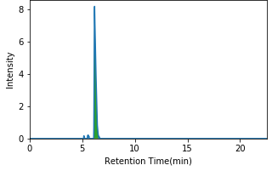

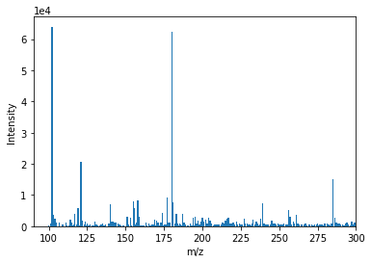
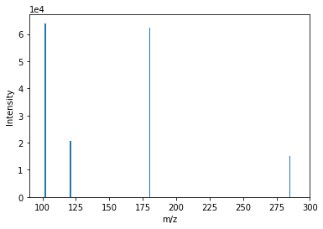
Feature extraction & alignment
mz | rt | SN | score | peak area
300 | 10 | 100 | 1 | 1e7
… | … | … | … | …
Python object
Remove noise detections
Alignment of results from different samples
File import
Peak list
Noise removal
Alignment
Read mzml file into the pipeline
Extract peaks from chromatogram
mz | rt | SN | score | peak area
300 | 10 | 100 | 1 | 1.00E+07
… | … | … | … | …
mz | rt | SN | score | peak area
300 | 10 | 100 | 1 | 1.00E+07
… | … | … | … | …
mz | rt | SN | score | peak area
300 | 10 | 100 | 1 | 1e7
… | … | … | … | …
Avg. mz | Avg. rt | Avg. SN | Avg. Score | Sample 1 peak area | Sample 2 peak area | …
300 | 10 | 100 | 1 | 1e7 | 1e8 | …
… | … | … | … | … |  | …

Slide 5
Feature extraction & alignment
mss_process
Remove noise detections
Alignment of results from different samples
File import
Peak list
Noise removal
Alignment
Read mzml file into the pipeline
Extract peaks from chromatogram
Avg. mz | Avg. rt | Avg. SN | Avg. Score | Sample 1 peak area | Sample 2 peak area | …
300 | 10 | 100 | 1 | 1e7 | 1e8 | …
… | … | … | … | … |  | …

Slide 6
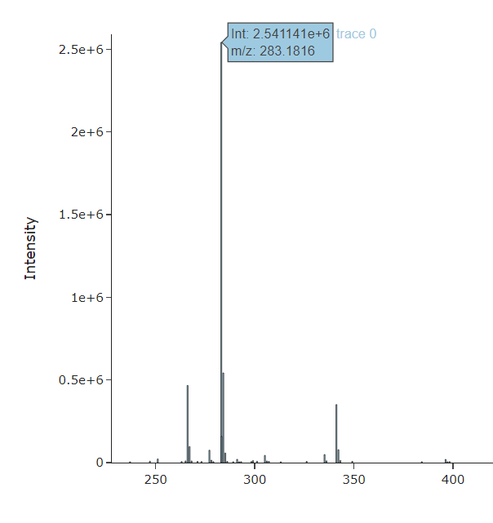
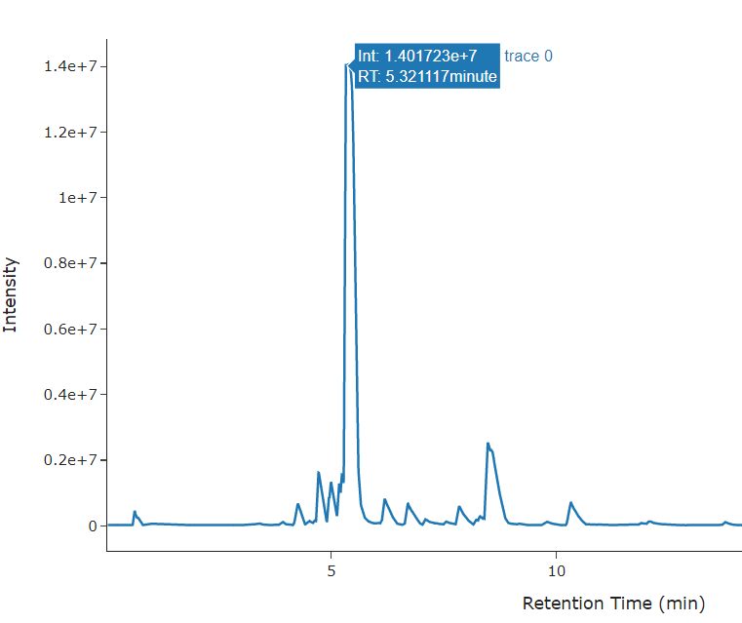


Example showcase
Data interactive interface
Chromatogram plot
Mass spectrum
Other options:
TIC plot
Isotopic plot
Peak Integration
https://github.com/XiminHu/mass-suite
Notes:
Showcase 2

Slide 7
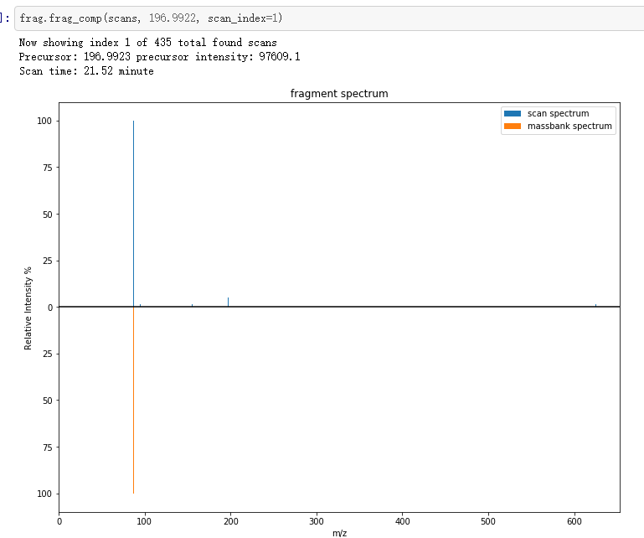
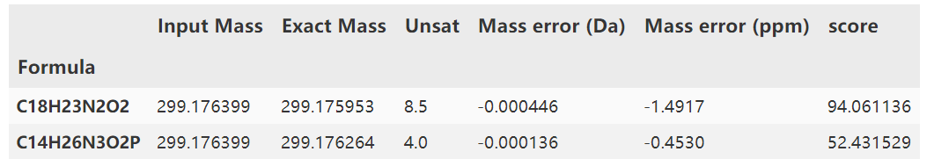
Formula annotation
Interactive plot for HRMS data visualization
Feature annotation
With online/in-house database
…
Scan spectrum
Database spectrum
m/z
https://github.com/XiminHu/mass-suite
Notes:
Showcase 3

Slide 8
Reliability
Comparison between different platforms
Annotation with in-house standards
https://github.com/XiminHu/mass-suite
Notes:
As a new tool, the package needs to be reliable to users in order to produce robust results, thus two tests were conducted

Slide 9

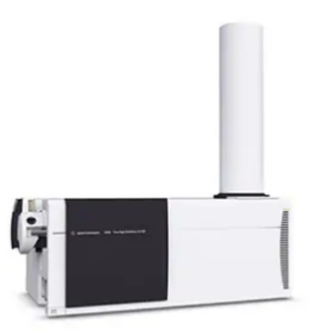

Peak detection
Samples with 413 known compound spiked were processed by Mass-suite
only matched through MS1 chromatograms using mz/rt pairs
mz | rt | peak area
300 | 10 | 1e7
… | … | …
mz | rt | peak area
300 | 10 | 1e7
… | … | …
Manual found peak list
Mass-suite peak list
* Mismatch derives from bad peak shape and function parameter settings
Notes:
Using a known compound spiked sample processed through mass-suite, the result showed 99% of the compound peaks in the list were found.

Slide 10
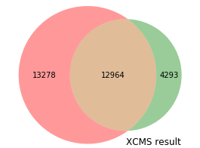
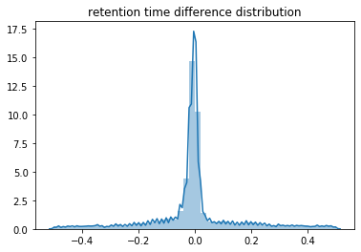
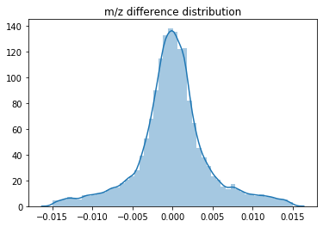
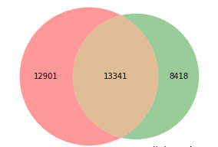
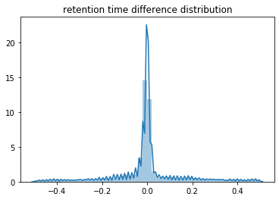
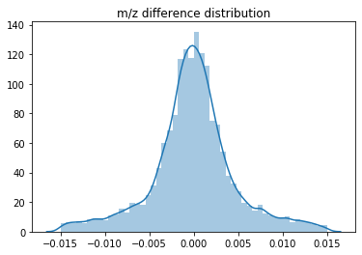
Mass-suite
XCMS
Mass difference
XCMS
RT difference
Mass-suite
MSdial
Mass difference
MSdial
RT difference
*Test done on the same sample (set of 3) with same parameter, XCMS processed on the web interface
Notes:
Venn diagram showed majorities of features were overlapped from Mass-suite and selected platform, the distribution plot suggests the rt/mz slicing is comparable
Bigger texts for the plots

Slide 11
Data mining
Statistical analysis
Clustering analysis
Quantitative source apportionment
Mass-suite provides various tools for Non-target HRMS data analysis
https://github.com/XiminHu/mass-suite

Slide 12
Statistical analysis
PCA/T-SNE
Hypothesis
testing
Volcano plot
Similarity comparison
Etc.
Basic statistical analysis based on built-in python functions:
https://github.com/XiminHu/mass-suite
Notes:
The statistical module provides essential analysis tools for common workflow

Slide 13
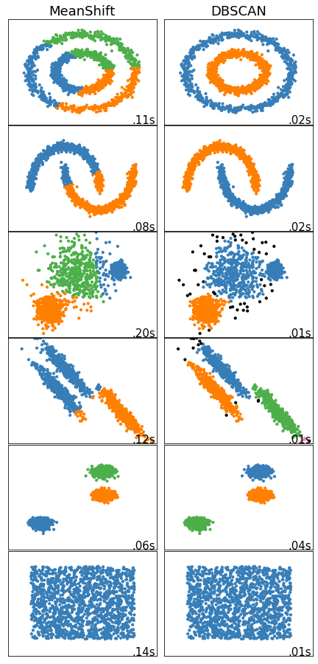
Clustering analysis
Based mainly on Density-based spatial clustering of applications with noise algorithm
Cluster the features with similar trend
No need for detailed comprehension
Suitable for various studies
Middle image source: https://scikit-learn.org/stable/auto_examples/cluster/plot_cluster_comparison.html#sphx-glr-auto-examples-cluster-plot-cluster-comparison-py
Notes:
Clustering analysis provides a straight forward results of how the features look like when comparing to each others,
The algorithm aims at grouping the features that behaves similar while excluding the noises.
Advantage: showed as left, no need to know details for the data such as predefined cluster number, or data distribution; suitable for various studies such as time series, WWTP treatment assessment, or even spatial difference comparison

Slide 14
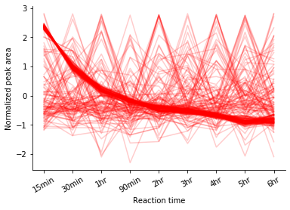
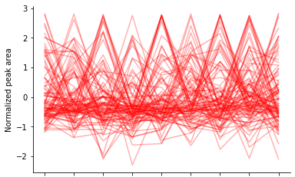
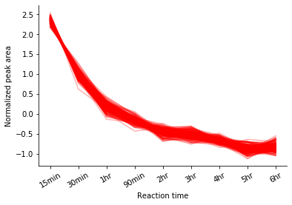
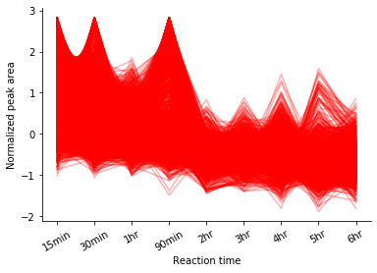
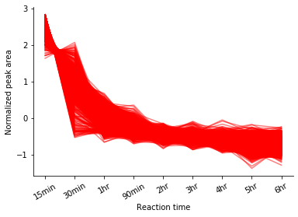
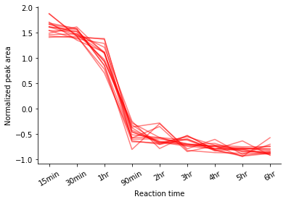
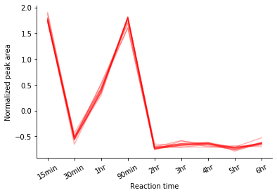
Distinguishing noise
Find similar features with error tolerance
Distinguish between different behaviors
* All data obtained from a time-series leaching experiment, normalization were conducted prior to clustering
Notes:
Overall, the algorithm provides a quick and accurate approach for the feature prioritization

Slide 15
Quantitative source apportionment
Watershed mixtures*
Modeling
Model options:
Linear regression
Lasso regression
Random Forest
SVM
…
Single chemical
Multiple clusters
Single cluster
Individual models
Ensemble method
Multivariate model
Single variate regression
100% Highway runoff
Creek A
30% Highway runoff
Creek B
?% Highway runoff
10% Highway runoff
Other Creeks
4% Highway runoff
* Reference: Katherine T. Peter et al., Application of Nontarget High Resolution Mass Spectrometry Data to Quantitative Source Apportionment, Environmental Science & Technology 2019 53 (21), 12257-12268 DOI: 10.1021/acs.est.9b04481
Notes:
Using the sample on the left, combing with the clustering algorithm, here developed a modeling module in the package designated for the source quantitative analysis
There are flexible options, either using one chemical, multiple chemicals with similar behavior, or multiple groups chemicals with different trend, user can build their model and make prediction out of it

Slide 16
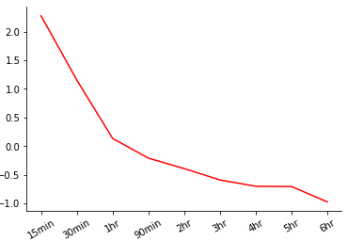
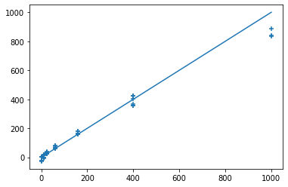
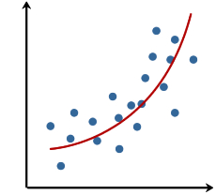
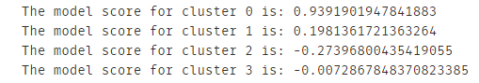
Quantitative source apportionment
1. Choose the option
2. Build model
3. Make prediction
Select among single chemical, single cluster or multiple clusters for modeling
Built the model based on selected algorithm
Get prediction of source apportionment using models
100% Highway runoff
Creek A
30% Source
Creek B
10% Source
Pred. Conc.
Other Creeks
4% Highway runoff
Actual Conc.

Slide 17
Functionality Comparison
Tool Features | Mass-suite | TidyMS | MZmine2 | XCMS* | MS-DIAL
Language | Python | Python | Java | R | C#
Rawdata preprocessing | √ | √ | √ | √ | √
QC-based batch correction | × | √ | × | × | ×
Quality reports | √ | √ | √ | × | √
Normalization, imputation, scaling | √ | √ | √ | × | √
Feature annotation | √ | × | √ | × | √
Isotope grouping | × | × | √ | √ | √
Interactive visualization plots | √ | × | √ | × | √
Clustering statistical analysis | √ | × | × | × | ×
Modeling tools | √ | × | × | × | ×
* XCMS is supported by various of R packages and mostly functioning as a starting point
** Functionality counted could be missing some features due to delay of software update
Reference: Riquelme G, Zabalegui N, Marchi P, Jones CM, Monge ME. A Python-Based Pipeline for Preprocessing LC-MS Data for Untargeted Metabolomics Workflows. Metabolites. 2020 Oct 16;10(10):416. doi: 10.3390/metabo10100416. PMID: 33081373; PMCID: PMC7602939.
Notes:
Here is a comparison chart, As mentioned at beginning ,mass-suite is designed towards full-stack capacity, and it built it’s novelty on the datamining tools especially the clustering analysis
Formatting to hightlight

Slide 18
Benchmarks
70%
Agreement on feature detection
As reliable as other platforms
99%
Accuracy of peak picking
With additional scoring based on RandomForest model
8 min/file*
Average processing time
Capable to be boosted up by supercomputers
30 Mb
Package size
Light for the installation and use
4 Tools
Powering Non-target analysis
Based on data science approaches
Open Source
Of the entire package
Keep updating, anyone can be involved
*Tested under default parameters as intensity cutoff = 3000, mz error = 10 ppm, alignment mz error = 10 ppm, rt error = 0.5 min, model_scoring was off, test were performed on personal laptop (Intel(R) Core(TM) i7-7700HQ CPU, 16GB RAM)
Notes:
Statistical tools, clustering tools, modeling tools and source identification tool (in dev)
Here are some benchmarks for the tool, As shown above, the tool is reliable, portable, and flexible

Slide 19
Development Roadmap
Testing
Dynamically update
Source identification
1
3
5
2
4
6
Annotation tool
GUI/web tool
Even more…
Notes:
Here is a roadmap for future development, will start from public beta test/debugging, finish up some tools such as annotation, identification and non-programmer friendly interface
The package will keep updating according to the feedback and needs

Slide 20
Related information
Github page & documentation:
https://github.com/XiminHu/mass-suite
Installation:
https://pypi.org/project/mass-suite/
Contact:
xhu66@uw.edu
Suggestions & Collaborations
are always welcome !

Slide 21
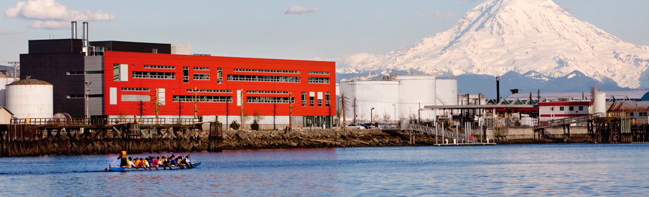

Acknowledgement:
A big shout to Professor Edward Kolodziej, Professor David Beck, Dr. Katherine Peter, and the Center for Urban Waters for all their help during the development of this package.

Slide 22
References & dependencies
M Kösters et al; pymzML v2.0: introducing a highly compressed and seekable gzip format, Bioinformatics, doi: https://doi.org/10.1093/bioinformatics/bty046
Pedregosa et al., Scikit-learn: Machine Learning in Python, JMLR 12, pp. 2825-2830, 2011.
Martin Ester et al. 1996. A density-based algorithm for discovering clusters in large spatial databases with noise. In Proceedings of the Second International Conference on Knowledge Discovery and Data Mining (KDD'96). AAAI Press, 226–231.
Riquelme G et al. A Python-Based Pipeline for Preprocessing LC-MS Data for Untargeted Metabolomics Workflows. Metabolites. 2020 Oct 16;10(10):416. doi: 10.3390/metabo10100416. PMID: 33081373; PMCID: PMC7602939.
Tsugawa, Hiroshi et al. “MS-DIAL: data-independent MS/MS deconvolution for comprehensive metabolome analysis.” Nature methods vol. 12,6 (2015): 523-6. doi:10.1038/nmeth.3393
Horai, H. et al (2010), MassBank: a public repository for sharing mass spectral data for life sciences. J. Mass Spectrom., 45: 703-714. https://doi.org/10.1002/jms.1777
Katherine T. Peter et al., Application of Nontarget High Resolution Mass Spectrometry Data to Quantitative Source Apportionment, Environmental Science & Technology 2019 53 (21), 12257-12268 DOI: 10.1021/acs.est.9b04481
Mass-suite requires major dependencies:
Pandas 1.0.3 or higher
Numpy 1.16.5 or higher
Scikit-learn 0.23.0 or higher
Scipy 1.4.1 or higher
pymzml 2.4.6 or higher
PeakUtils 1.3.3 or higher
plotly 4.5.2 or higher
Optional dependencies for machine-learning:
Keras 2.3.1
Tensorflow 2.0.0
Pytorch 1.4.0 or higher

Slide 23

Thanks!
Github page & documentation:
https://github.com/XiminHu/mass-suite
Contact:
xhu66@uw.edu

